Slide 1

UNIT II - SOFTWARE REQUIREMENTS AND ANALYSIS

Slide 2

Requirements Engineering
Unit : II
The broad spectrum of tasks and techniques that lead to an understanding of requirements is called requirements engineering.
From a software process perspective, requirements engineering is a major software engineering action that begins during the communication activity and continues into the modeling activity.
It must be adapted to the needs of the process, the project, the product, and the people doing the work.
Requirements engineering provides the appropriate mechanism for understanding what the customer wants, analyzing need, assessing feasibility, negotiating a reasonable solution, specifying the solution clearly, validating the specification, and managing the requirements as they are transformed into an operational system.
7 distinct tasks: Inception, Elicitation, Elaboration, Negotiation, Specification, Validation, and Management.

Slide 3
Unit : II
Inception—ask a set of questions that establish …
basic understanding of the problem
the people who want a solution
the nature of the solution that is desired, and
the effectiveness of preliminary communication and collaboration between the customer and the developer.
Elicitation
Elicit requirements from all stakeholders (customer, users, etc.)
Why requirement elicitation is difficult?
Problem of Scope: The boundary of the system is ill-defined.
Problems of Understanding: The customer/users are not sure of what is needed. They may have a poor understanding of the capabilities and limitations of their computing environment, don’t have a full understanding of the problem domain.
Problems of Volatility: The requirements change over time.

Slide 4
Unit : II
Elaboration
Create an analysis model that identifies data, function and behavioral requirements.
It is driven by the creation and refinement of user scenarios that describe how the end-user will act with the system.
Negotiation
It is relatively common for different customers or users to propose conflicting requirements
Customers, users, and other stakeholders are asked to rank requirements and then discuss conflicts in priority.
Risks in each requirement are identified and analyzed.
Agree on a deliverable system that is realistic for developers and customers.

Slide 5
Unit : II
Specification (means different things to different people)
Can be any one (or more) of the following:
A written document
A set of models
A formal mathematical
A collection of user scenarios (use-cases)
A prototype
Validation
Requirements validation examines the specification
to ensure that all software requirements have been
stated unambiguously; inconsistencies, omissions, and
errors have been detected and corrected;

Slide 6
Unit : II
Validation (contd..)
- mechanism is the technical review
- review team that validates requirements includes
looking for errors in content or interpretation
areas where clarification may be required,
missing information
inconsistencies
conflicting requirements, or unrealistic requirements
Requirements management
Set of activities that help the project team identify, control, and track requirements and changes to requirements at any time as the project proceeds.

Slide 7
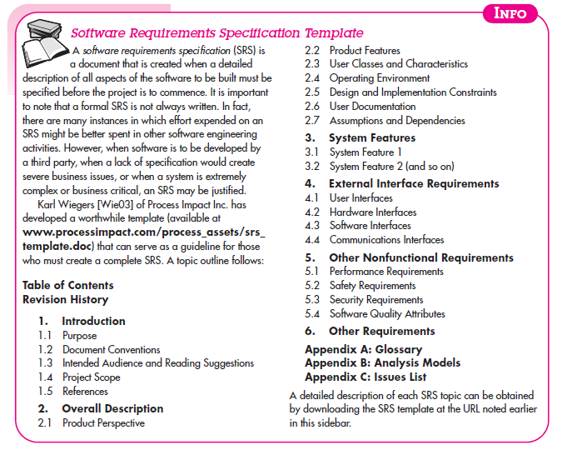
Unit : II

Slide 8
Establishing the Groundwork
Unit : II
Steps for understanding the software requirements
Identifying Stakeholders
Stakeholder - “anyone who benefits in a direct or indirect way from the system
Operations managers, product managers, marketing people, internal and external customers, end-users, consultants, product engineers, software engineers, support and maintenance engineers, etc.
At inception, the requirements engineer should create a list of people who will contribute input as requirements are elicited.

Slide 9
Unit : II
Recognizing Multiple Viewpoints
Different stakeholders exist - the requirements of the system will be explored from many different points of view
As information from multiple viewpoints is collected, emerging requirements may be inconsistent or may conflict with one another.
The requirements engineer is to categorize all stakeholder information including inconsistencies and conflicting requirements in a way that will allow decision makers to choose an internally consistent set of requirements for the system.
Working toward Collaboration
Collaboration does not necessarily mean that requirements are defined by committee.
In many cases, stakeholders collaborate by providing their view of requirements, but a strong “project champion” (business manager, or a senior technologist) may make the final decision about which requirements make the final cut.

Slide 10
Unit : II
Asking the First Questions
The first set of context-free questions focuses on the customer and other stakeholders, overall goals, and benefits.
The first questions:
-Who is behind the request for this work?
- Who will use the solution?
- What will be the economic benefit of a successful solution?
- Is there another source for the solution that you need?
These questions help to identify all stakeholders who will have interest in the software to be built.

Slide 11
Unit : II
The next set of questions enables you to gain a better understanding of the problem and allows the customer to voice his or her perceptions about a solution:
-How would you characterize “good” output that would be generated by a successful solution?
-What problem(s) will this solution address?
-Can you show me (or describe) the business environment in which the solution will be used?
-Will special performance issues or constraints affect the way the solution is approached?
The final set of questions focuses on the effectiveness of the communication activity itself. Gause and Weinberg [Gau89] call these “meta-questions” and propose the following (abbreviated) list.

Slide 12
Unit : II
Are you the right person to answer these questions? Are your answers “official”?
Are my questions relevant to the problem that you have?
Am I asking too many questions?
Can anyone else provide additional information?
Should I be asking you anything else?

Slide 13
Eliciting Requirements
Unit : II
Requirements elicitation (also called requirements gathering) combines elements of problem solving, elaboration, negotiation, and specification.
1.Collaborative Requirements Gathering
Gathering the requirements by conducting the meetings between developer and customer.
Fix the rules for preparation and participation.
The main motive is to identify the problem, give the solutions for the elements, negotiate the different approaches and specify the primary set of solution requirements in an environment which is valuable for achieving goal.

Slide 14
Unit : II
2.Quality Function Deployment (QFD)
In this technique, translate the customer need into the technical requirement for the software.
QFD “concentrates on maximizing customer satisfaction from the software engineering process”
QFD identifies 3 types of requirements:
Normal requirements: The objectives and goals that are stated for a product or system during meetings with the customer. If these requirements are present, the customer is satisfied.
Examples of normal requirements might be requested types of graphical displays, specific system functions, and defined levels of performance.

Slide 15
Unit : II
Expected requirements: These requirements are implicit.
These are the basic requirement that not be clearly told by the customer, but also the customer expect that requirement. (Ex: easiness of UI)
Exciting requirements: These features are beyond the expectation of the customer.
The developer adds some additional features or unexpected feature into the software to make the customer more satisfied. For example, the mobile phone with standard features, but the developer adds few additional functionalities like voice searching, multi-touch screen etc. then the customer more exited about that feature.

Slide 16
Unit : II
3. Usage scenarios
Till the software team does not understand how the features and function are used by the end users it is difficult to move technical activities.
To achieve above problem the software team produces a set of structure that identify the usage for the software.
This structure is called as 'Use Cases'.
4. Elicitation work product
The work product created as a result of requirement elicitation that is depending on the size of the system or product to be built.

Slide 17
Unit : II
A statement of need and feasibility.
A bounded statement of scope for the system or product.
A list of customers, users, and other stakeholders who participated in requirements elicitation.
A description of the system’s technical environment.
A list of requirements (preferably organized by function) and the domain constraints that apply to each.
A set of usage scenarios that provide insight into the use of the system or product under different operating conditions.
Any prototypes developed to better define requirements

Slide 18
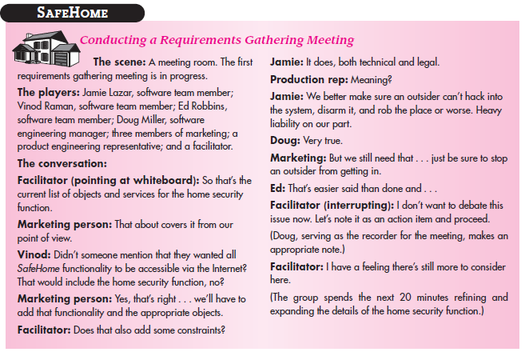
Unit : II

Slide 19
Developing Use cases
Unit : II
Use case tells a story about how an end user (playing one of a number of possible roles) interacts with the system under a specific set of circumstances. The story may be narrative text, an outline of tasks or interactions, a template-based description, or a diagrammatic representation.
Use case depicts the software or system from the end user’s point of view.
The first step in writing a use case is to define the set of “actors” that will be involved in the story.
An actor is a role that people (users) or devices play as they interact with the software.
It is important to note that an actor and an end user are not necessarily the same thing.

Slide 20
Unit : II
A typical user may play a number of different roles when using a system, whereas an actor represents a class of external entities (often, but not always, people) that play just one role in the context of the use case.
As an example, consider a machine operator (a user) who interacts with the control computer for a manufacturing cell that contains a number of robots and numerically controlled machines.
software for the control computer requires four different modes (roles) for interaction: programming mode, test mode, monitoring mode, and troubleshooting mode.
Therefore, four actors can be defined: programmer, tester, monitor, and troubleshooter. In some cases, the machine operator can play all of these roles. In others, different people may play the role of each actor.

Slide 21
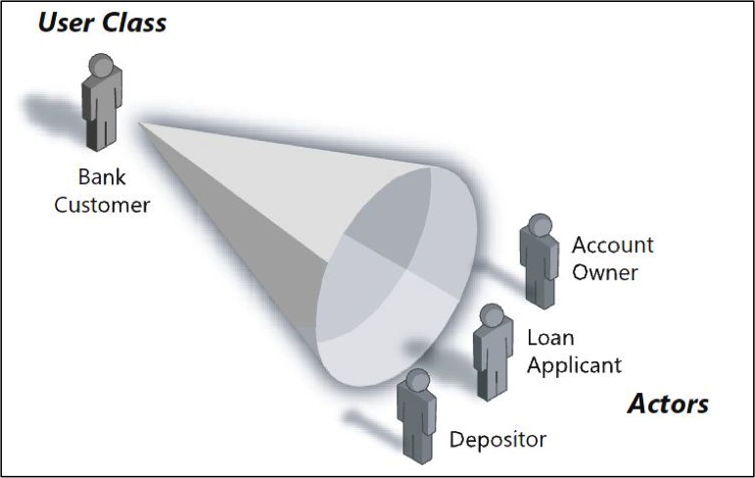
User and the Actor
Unit : II

Slide 22
Unit : II
Once actors have been identified, use cases can be developed. Jacobson [ Jac92] suggests a number of questions that should be answered by a use case:
Who is the primary actor, the secondary actor(s)?
What are the actor’s goals?
What preconditions should exist before the story begins?
What main tasks or functions are performed by the actor?
What exceptions might be considered as the story is described?
What variations in the actor’s interaction are possible?
What system information will the actor acquire, produce, or change?
Will the actor have to inform the system about changes in the external environment?
What information does the actor desire from the system?
Does the actor wish to be informed about unexpected changes?

Slide 23
Unit : II
Primary actors interact to achieve required system function and derive the intended benefit from the system. They work directly and frequently with the software.
Secondary actors support the system so that primary actors can do their work.

Slide 24
BUILDING THE REQUIREMENTS MODEL
Unit : II
Elements of the Requirements Model
Scenario-based elements :The system is described from the user’s point of view using a scenario-based approach. For example, basic use cases and their corresponding use-case diagrams.
Use Case Modeling – Define software functional requirements in terms of use cases and actors .
Activity Diagrams – represented using Use Cases

Slide 25
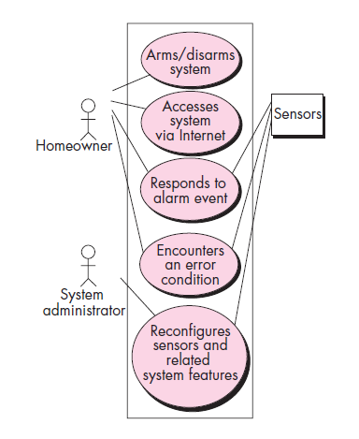
UML use case diagram for Safe Home security function
Unit : II

Slide 26
Unit : II
Class-based elements: Each usage scenario implies a set of objects that are manipulated as an actor interacts with the system.
These objects are categorized into classes—a collection of things that have similar attributes and common behaviors.
other analysis modeling elements depict the manner in which classes collaborate with one another and the relationships and interactions between classes
For example, a UML class diagram can be used to depict a Sensor class for the SafeHome security function.

Slide 27
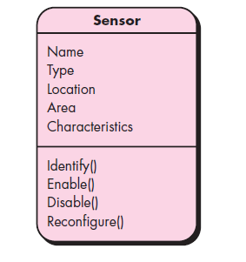
Class diagram for sensor
Unit : II
The diagram lists the attributes of sensors (e.g., name, type) and the operations (e.g., identify, enable)

Slide 28
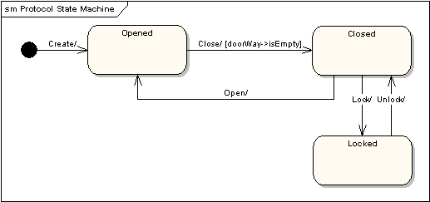
Unit : II
Behavioral elements: Requirements model must provide modeling elements that depict behavior.
The state diagram is one method for representing the behavior of a system by depicting its states and the events that cause the system to change state.
A state is any externally observable mode of behavior. In addition, the state diagram indicates actions (e.g., process activation) taken as a consequence of a particular event.

Slide 29
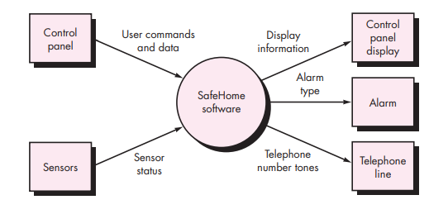
Unit : II
Flow-oriented elements: Information is transformed as it flows through a computer-based system.
The system accepts input in a variety of forms, applies functions to transform it, and produces output in a variety of forms.
DFD (Data Flow Diagrams)
CONTEXT FLOW DIAGRAM – SAFEHOME SYSTEM

Slide 30
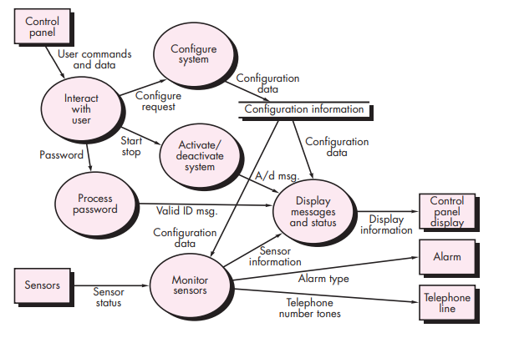
Unit : II
LEVEL 1 DFD – SECURITY FUNCTION IN SAFEHOME SYSTEM

Slide 31
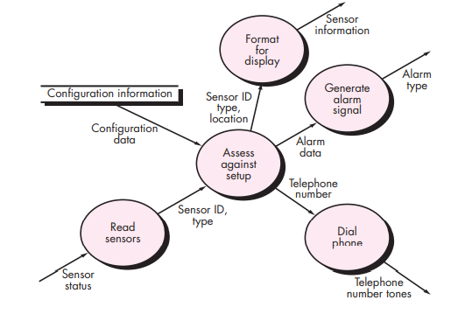
Unit : II
LEVEL 2 DFD – refines the monitor sensors process

Slide 32
Unit : II
Flow-oriented elements: Information is transformed as it flows through a computer-based system.
The system accepts input in a variety of forms, applies functions to transform it, and produces output in a variety of forms.
DFD (Data Flow Diagrams)
Analysis Patterns
certain problems reoccur across all projects within a specific application domain
Analysis patterns suggest solutions (e.g., a class, a function, a behavior) within the application domain that can be reused when modeling many applications.

Slide 33
Unit : II
Geyer-Schulz and Hahsler suggest two benefits that can be associated with the use of analysis patterns:
First, analysis patterns speed up the development of abstract analysis models that capture the main requirements of the concrete problem by providing reusable analysis models
Second, analysis patterns facilitate the transformation of the analysis model into a design model by suggesting design patterns and reliable solutions for common problems.

Slide 34
Negotiating Requirements
Unit : II
In an ideal requirements engineering context, the inception, elicitation, and elaboration tasks determine customer requirements in sufficient detail to proceed to subsequent software engineering activities.
Unfortunately, this rarely happens. In reality, you may have to enter into a negotiation with one or more stakeholders.
In most cases, stakeholders are asked to balance functionality, performance, and other product or system characteristics against cost and time-to-market. The intent of this negotiation is to develop a project plan that meets stakeholder needs while at the same time reflecting the real-world constraints (e.g., time, people, budget) that have been placed on the software team.

Slide 35
Unit : II
The best negotiations strive for a “win-win” result.
- stakeholders win by getting the system or product that satisfies the majority of their needs
- software team member win by working to realistic and achievable budgets and deadlines.
Boehm defines a set of negotiation activities at the beginning of each software process iteration.
1. Identification of the system or subsystem’s key stakeholders.
2. Determination of the stakeholders’ “win conditions.”
3. Negotiation of the stakeholders’ win conditions to reconcile them into a set of win-win conditions for all concerned (including the software team).
Successful completion of these initial steps achieves a win-win result, which becomes the key criterion for proceeding to subsequent software engineering activities.

Slide 36
Validating Requirements
Unit : II
As each element of the requirements model is created, it is examined for inconsistency, omissions, and ambiguity.
The requirements represented by the model are prioritized by the stakeholders and grouped within requirements packages that will be implemented as software increments.
A review of the requirements model addresses the following questions:
Is each requirement consistent with the overall objectives for the system/product?
Have all requirements been specified at the proper level of abstraction? That is, do some requirements provide a level of technical detail that is inappropriate at this stage?

Slide 37
Unit : II
Is the requirement really necessary or does it represent an add-on feature that may not be essential to the objective of the system?
Is each requirement bounded and unambiguous?
Does each requirement have attribution? That is, is a source (generally, a specific individual) noted for each requirement?
Do any requirements conflict with other requirements?
Is each requirement achievable in the technical environment that will house the system or product?
Is each requirement testable, once implemented?
Does the requirements model properly reflect the information, function, and behavior of the system to be built?

Slide 38
Unit : II
Has the requirements model been “partitioned” in a way that exposes progressively more detailed information about the system?
Have requirements patterns been used to simplify the requirements model?
Have all patterns been properly validated? Are all patterns consistent with customer requirements?

Slide 39
Requirements Analysis
Unit : II
Requirements analysis allows you to elaborate on basic requirements established during the inception, elicitation, and negotiation tasks that are part of requirements engineering.
IEEE defines requirements analysis as the process of studying user needs to arrive at a definition of a system, hardware or software requirements.
Various other tasks performed using requirements analysis are listed below.
To detect and resolve conflicts that arise due to unclear and unspecified requirements
To determine operational characteristics of the software and how they interact with the environment
To understand the problem for which the software is to be developed
To develop an analysis model to analyze the requirements in the software.

Slide 40
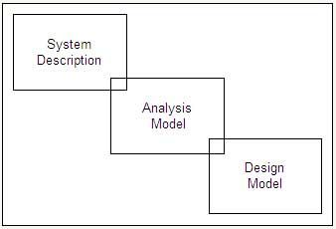
Unit : II
An analysis model created for the software facilitates the software development team to understand what is required in the software and then they develop it.
The analysis model connects the system description and design model.
System description provides information about the entire functionality of the system, which is achieved by implementing the software, hardware and data.

Slide 41
Unit : II
Design model provides information about the software's architecture, user interface, and component level structure.
The guidelines followed while creating an analysis model are listed below.
The model should concentrate on requirements in the problem domain that are to be accomplished. However, it should not describe the procedure to accomplish the requirements in the system.
Every element of the analysis model should help in understanding the software requirements. This model should also describe the information domain, function, and behavior of the system.
The analysis model should be useful to all stakeholders because every stakeholder uses this model in his own manner. For example, business stakeholders use this model to validate requirements whereas software designers view this model as a basis for design.
The analysis model should be as simple as possible. For this, additional diagrams that depict no new or unnecessary information should be avoided.

Slide 42
Unit : II
Also, abbreviations and acronyms should be used instead of complete notations.
Domain Analysis:
Software domain analysis is the identification, analysis, and specification of common requirements from a specific application domain, typically for reuse on multiple projects within that application domain. .
Object-oriented domain analysis is the identification, analysis, and specification of common, reusable capabilities within a specific application domain, in terms of common objects, classes, subassemblies, and frameworks.

Slide 43
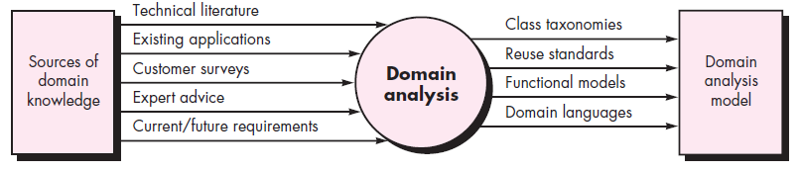
Input and output for domain analysis
Unit : II

Slide 44
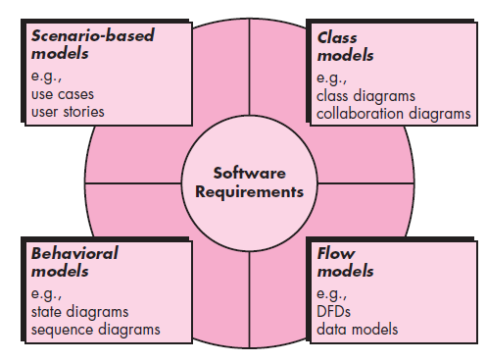
Elements of the analysis model
Unit : II

Slide 45
Requirements Modeling Strategies
Unit : II
One view of requirements modeling, called structured analysis, considers data and the processes that transform the data as separate entities.
Data objects are modeled in a way that defines their attributes and relationships.
Processes that manipulate data objects are modeled in a manner that shows how they transform data as data objects flow through the system.
A second approach to analysis modeling, called object-oriented analysis, focuses on the definition of classes and the manner in which they collaborate with one another to effect customer requirements.

Slide 46


